Slide 1

Write text files; Lists: traversal; Operations
Python Programming | Loops, string, files, list, dictionaries and tuples
Course: Python Programming | Chapter: Loops, string, files, list, dictionaries and tuples | Program: Bachelor of Computer Science and Engineering
DISCOVER · LEARN · EMPOWER
Notes:
Welcome everyone to today's session on Python programming. We will focus specifically on writing text files and mastering list operations like traversal. This builds directly on our previous work with loops and strings. Remember, mastering these concepts is essential for efficient data processing in real-world engineering applications.

Slide 2
Course Outcomes
SLIDE 2 / 14
Course Outcome
CO | BT LEVEL | DESCRIPTION
CO1 | BT1 | Understand the syntax, control structures, and basic constructs of Python programming language
CO2 | BT3 | Apply functions, modules, and exception handling for modular program development
CO3 | BT3 | Implement data structures including lists, tuples, dictionaries, and sets for efficient data processing
CO4 | BT4 | Analyze and manipulate files, strings, and perform data handling operations
CO5 | BT5 | Design and develop real-world applications integrating multiple Python concepts
Chandigarh University
2 / 14
Notes:
Today's lecture directly addresses two specific Course Outcomes. First, CO3 requires us to implement data structures like lists for efficient processing. Second, CO4 focuses on analyzing and manipulating files and strings. By the end of this session, you will be able to write data to files and traverse lists effectively.

Slide 3
Learning Objectives
SLIDE 3 / 14
Learning Outcomes
1
Analyze the syntax and workflow for writing text files in Python
2
Evaluate different modes for file opening and their specific use cases
3
Demonstrate list traversal techniques using for loops and index access
4
Apply list operations such as appending, extending, and slicing effectively
5
Critique common pitfalls in file handling and list manipulation logic
Chandigarh University
3 / 14
Notes:
By the end of this class, you will be able to analyze how to write text files correctly. You will evaluate different file modes like write versus append. You will also demonstrate how to traverse lists using both index-based and element-based loops. Finally, we will critique common errors students make when handling these structures.

Slide 4
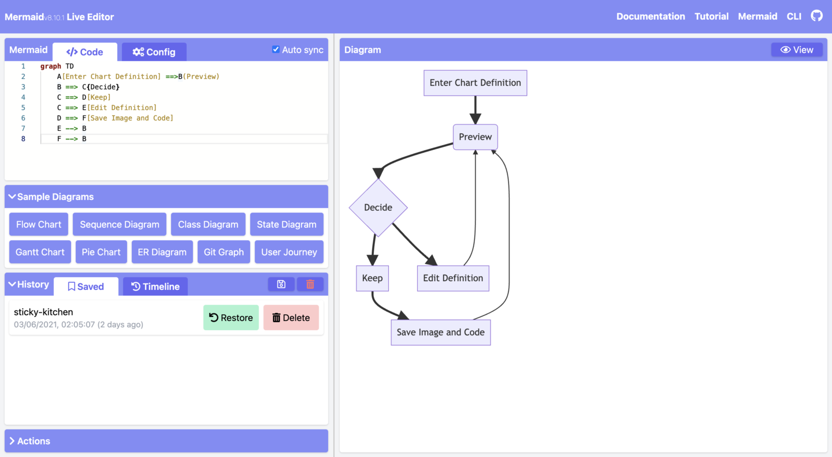
Writing Text Files
SLIDE 4 / 14
Basic Syntax
1
Use the open() function to create a file object before writing data
2
The syntax open(filename, mode) returns a file object for manipulation
3
Always use the 'with' statement to ensure files close automatically
4
The write() method accepts only string arguments, not numbers directly
5
Newlines must be added manually using the 'n' escape character
6
File objects must be in write mode to allow data output
7
Errors like FileNotFoundError occur if the directory path is incorrect
Write Better Code with Block Diagrams and Flowcharts - Nathan Jones
Chandigarh University
4 / 14
Notes:
Let's look at the basic syntax for writing files. You must use the open function with a specific mode. The 'with' statement is crucial because it handles closing the file automatically, even if an error occurs. Remember, the write method only accepts strings, so you must convert numbers to strings first. For example, writing 'Hello' requires a newline character to start the next line.

Slide 5
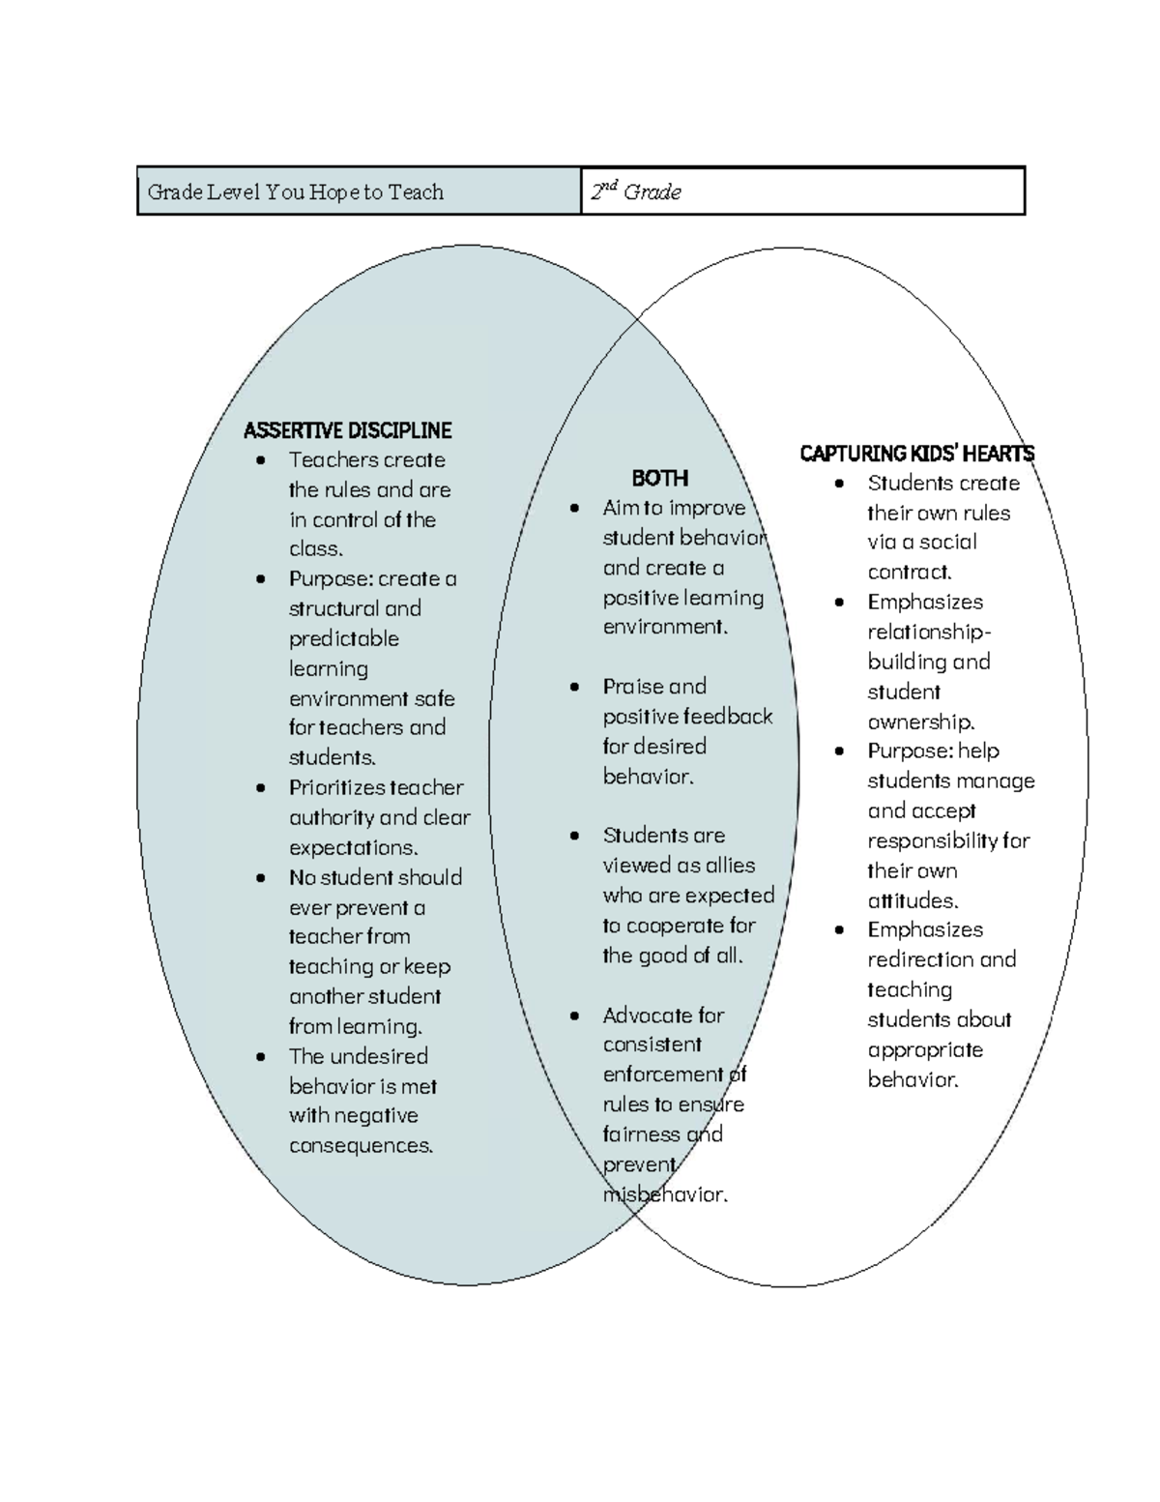
File Modes
SLIDE 5 / 14
Write vs Append
1
Mode 'w' creates a new file or overwrites an existing file completely
2
Mode 'a' opens a file for appending data to the end of content
3
Mode 'x' creates a new file but fails if the file already exists
4
Mode 'w+' opens a file for both reading and writing simultaneously
5
Mode 'a+' opens a file for both reading and appending simultaneously
6
Choosing the wrong mode can lead to accidental data loss in files
7
Always verify the file mode before performing write operations on data
Source: website-assets.studocu.com
Chandigarh University
5 / 14
Notes:
Understanding file modes is critical for data integrity. The 'w' mode will overwrite everything in an existing file, which is dangerous if you are not careful. In contrast, the 'a' mode appends data to the end without deleting existing content. If you use 'x', the program will crash if the file already exists, which is a safety feature. Always choose the mode that matches your intended data handling strategy.

Slide 6
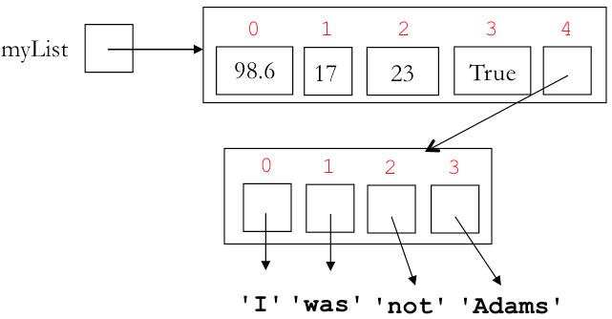
List Traversal
SLIDE 6 / 14
Index-Based Approach
1
Use range(len(list)) to iterate through indices of a list
2
Access elements using list_name[index] to modify data in place
3
This method allows simultaneous access to index and element values
4
Index starts at 0 and ends at length minus one for the list
5
Useful when you need to modify elements based on their position
6
Avoids creating a copy of the list during iteration
7
Can raise IndexError if the index exceeds the list length bounds
Source: cs111.wellesley.edu
Chandigarh University
6 / 14
Notes:
When traversing a list, you have two main approaches. The index-based approach uses range(len(list)) to get the position. This is essential when you need to modify the list in place or access the index value. For example, if you want to double every element, you need the index to assign the new value back to the list. Be careful not to access an index that is out of bounds.

Slide 7
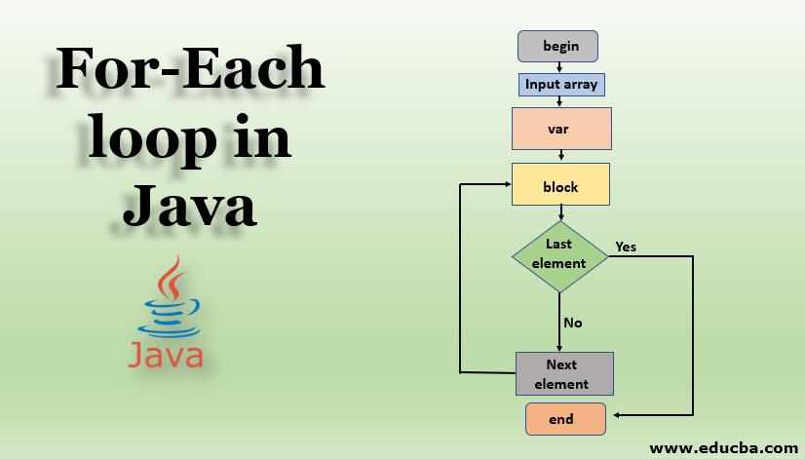
List Traversal
SLIDE 7 / 14
Element-Based Approach
1
Use 'for element in list' to iterate directly over list items
2
This method is cleaner and more Pythonic for read-only operations
3
You cannot modify the list structure directly using this loop
4
The variable holds a copy of the element value, not the reference
5
Ideal for printing, summing, or searching for specific values
6
Reduces the risk of index errors during iteration
7
Cannot be used to change the original list elements directly
Source: cdn.educba.com
Chandigarh University
7 / 14
Notes:
The element-based approach is often preferred for reading data. You simply write 'for item in my_list' to get each value. This is cleaner and less prone to index errors. However, you cannot modify the list elements directly because the loop variable is just a copy of the value. If you need to change the list, you must use the index-based method or create a new list.

Slide 8
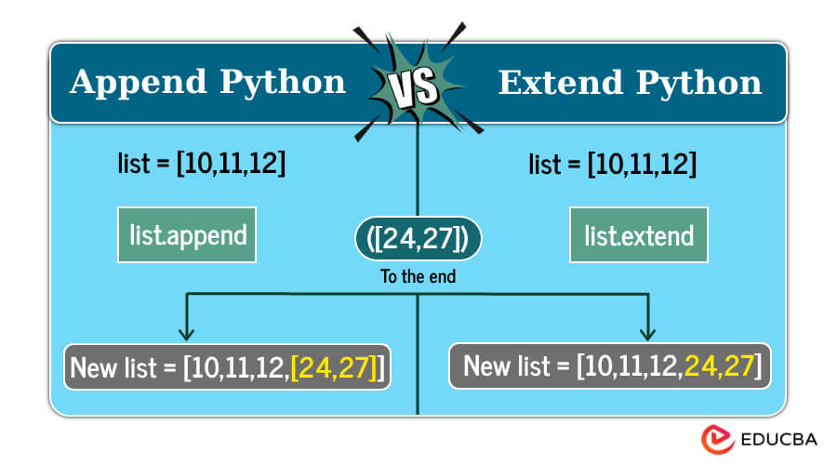
List Operations
SLIDE 8 / 14
Appending and Extending
1
The append() method adds a single element to the end of the list
2
The extend() method adds all elements from an iterable to the list
3
append() treats the argument as a single item, even if it is a list
4
extend() unpacks the iterable and adds each element individually
5
Using append() on a list creates a nested list structure
6
Extending is faster for adding multiple items than repeated appending
7
Both methods modify the original list in place without creating copies
Source: cdn.educba.com
Chandigarh University
8 / 14
Notes:
Let's distinguish between append and extend. The append method adds its argument as a single element. If you append a list, you get a nested list. The extend method unpacks the iterable and adds each element individually. For example, extending [1, 2] with [3, 4] results in [1, 2, 3, 4]. Using append would result in [1, 2, [3, 4]]. Always choose the method that matches your desired data structure.

Slide 9
List Operations
SLIDE 9 / 14
Slicing and Copying
1
Slicing uses the syntax list[start:end] to extract a sub-list
2
The end index is exclusive and not included in the result
3
Omitting start defaults to 0, omitting end defaults to list length
4
Negative indices allow slicing from the end of the list backwards
5
The slice operator creates a new list object, not a reference
6
Use slicing to create a shallow copy of the entire list
7
Slicing is efficient for extracting specific ranges of data for processing
Chandigarh University
9 / 14
Notes:
Slicing is a powerful tool for extracting parts of a list. The syntax list[start:end] gives you a new list from start up to, but not including, end. You can omit the start to begin at the beginning, or omit the end to go to the end. Negative indices are useful for accessing elements from the end. Remember, slicing creates a new list, so changes to the slice do not affect the original list.

Slide 10
Worked Example
SLIDE 10 / 14
Writing and Traversing
CREATE A LIST OF NUMBERS
[10, 20, 30, 40, 50] for the example
• Write each number to a file named 'data.txt' using a loop
• Convert each number to a string before writing to the file object
• Traverse the list using a for loop to print each element
• Calculate the sum of the list elements during the traversal
• Total sum calculated is 150 from the five input values
• File content shows each number on a separate line after execution
Chandigarh University
10 / 14
Notes:
Let's walk through a concrete example. We start with a list of numbers: 10, 20, 30, 40, 50. We open a file and loop through the list, converting each number to a string before writing. We also calculate the sum during this traversal. The total sum is 150. After the loop finishes, the file contains each number on a new line. This demonstrates both file writing and list traversal in one cohesive workflow.

Slide 11
Common Pitfall
SLIDE 11 / 14
File Not Closed
1
Forgetting to close a file can lead to data loss or corruption
2
Data may remain in the buffer and not be written to disk
3
Opening too many files without closing causes resource exhaustion
4
The 'with' statement automatically handles closing the file object
5
Manual close() calls are required if not using the 'with' block
6
Exceptions during writing can prevent the close() method from running
7
Always verify file integrity after writing operations in production code
Chandigarh University
11 / 14
Notes:
A common mistake is forgetting to close a file. If you don't close it, data might stay in the buffer and never reach the disk. This can lead to data loss. Using the 'with' statement prevents this because it guarantees the file closes even if an error occurs. If you do not use 'with', you must manually call close(), but this is risky if an exception happens before the call.

Slide 12
Common Pitfall
SLIDE 12 / 14
Modifying List During Loop
1
Modifying a list while iterating over it can cause index errors
2
Removing elements shifts indices, skipping subsequent items in the loop
3
Adding elements can lead to infinite loops if conditions are not met
4
Use a separate list to store items that need modification
5
Iterate over a copy of the list to avoid index shifting issues
6
Filtering lists is safer when creating a new list with conditions
7
Always review loop logic when changing list size dynamically
Chandigarh University
12 / 14
Notes:
Another critical pitfall is modifying a list while iterating over it. If you remove an element, the indices shift, and you might skip the next item. This can lead to logic errors where some items are never processed. The safest approach is to create a new list with the desired elements or iterate over a copy of the original list. Always be cautious when changing the size of a list during a loop.

Slide 13
Lecture
SLIDE 13 / 14
Key Takeaways
1
Use 'with open' to safely write text files and prevent data loss
2
Choose 'w' for overwriting and 'a' for appending to existing files
3
Use index-based loops to modify lists and element-based for reading
4
Distinguish between append() for single items and extend() for iterables
5
Slicing creates new lists and is essential for data extraction tasks
Chandigarh University
13 / 14
Notes:
To summarize, always use the 'with' statement for file operations to ensure safety. Remember the difference between write and append modes. For lists, choose your traversal method based on whether you need to modify the data. Distinguish clearly between append and extend operations. Finally, use slicing to extract data efficiently. These are the core skills you need for this chapter.

Slide 14
Lecture
SLIDE 14 / 14
References
PYTHON
A Practical Learning Approach, 1st Edition — T.S. Murugesh, Shriram K. Vasudevan, Sini Raj Pulari
• Learning Python, 6th Edition — Mark Lutz
• Starting Out with Python, Global Edition, 6th Edition — Tony Gaddis
• Introduction to Python Programming and Data Structures, 3rd Edition — Y. Daniel Liang
Chandigarh University
14 / 14
Notes:
These are the primary reference books for this course. Mark Lutz's book is excellent for deep dives into Python. Tony Gaddis provides a great introduction for beginners. Y. Daniel Liang's book covers data structures well. Finally, the practical approach by Murugesh et al. offers specific insights for engineering students. Please refer to these texts for further study.

